Slide 1


Slide 2
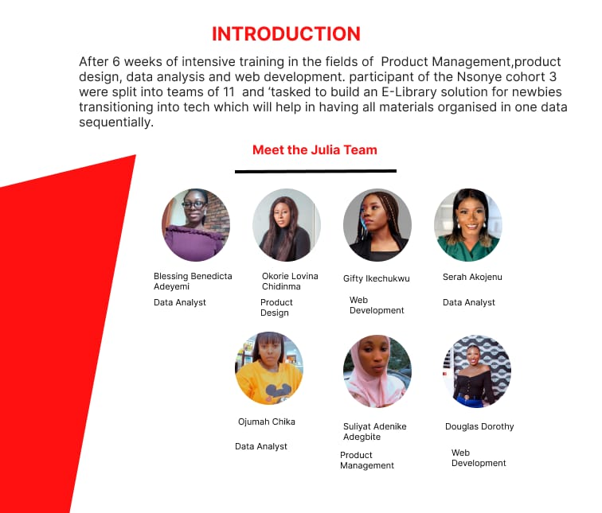
Notes:
Nsonye is a social impact organization bridging the technology gender-gap gap for Women and Girls across Africa. Through our engaging community and upskilling programs, we provide an entry pathway for Women and Girls to transition into the tech industry, while also providing them with mentorship and resources to ensure their continued growth.

Slide 3
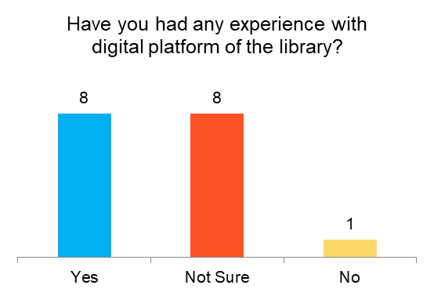
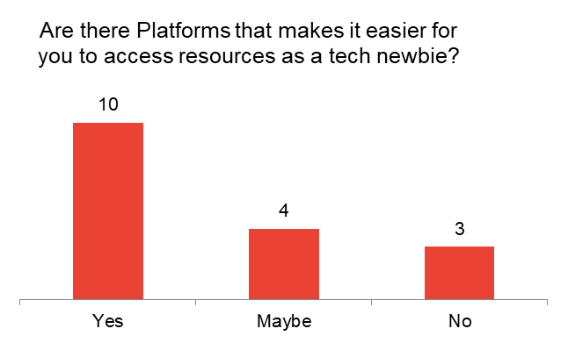
Understanding the Problem
Data shows that respondents get most of their study materials from lots of online platforms. Even though the percentage of those who get their study materials from various platform is 58.8%, yet only 47% of our respondents have had experience with an E-Library.
Why?
Lots of resources with no guidance (mentorship)
No structured learning path
Finance
Notes:
Lots of resources with no guidance/mentorship: There are lots of resources on the internet for those coming into tech or transitioning into tech but the lack of mentorship makes it difficult for people to know where to start from.
No structured learning path: since there is lack of mentorship, this makes new techies to be confused and study whatever is seen on the internet.
Finance: cost of learning or finding mentors is also a challenge

Slide 4
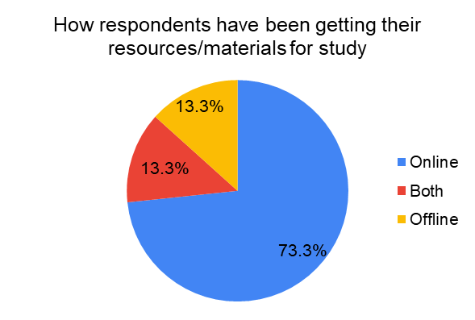
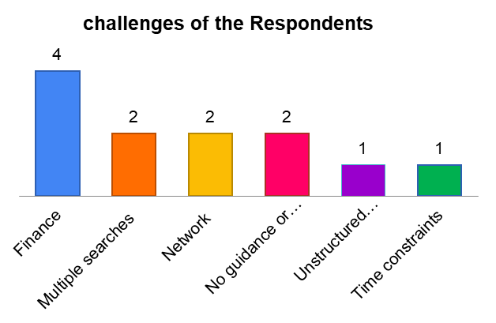
Details of Project
A quantitative analysis was carried out whereby 16 respondents were given a set of questions to answer. These questions were designed to help verify the importance of this solution provided by the Julia team. At the end of our research, we found out that only 13.3% of our respondents were not getting their study materials/resources offline.
Notes:
Finance 4
Multiple searches on the internet to get the right material 2
Network 2
No guidance or mentorship 2
Unstructured Learning Path 1
Time constraints 1

Slide 5
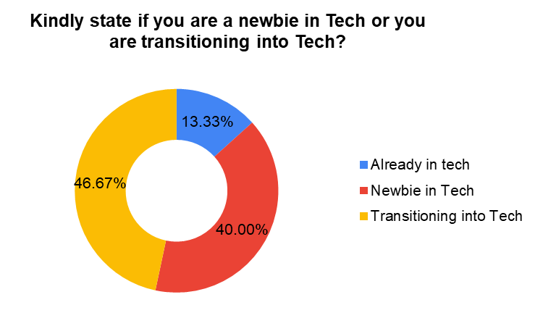
Kindly state if you are a newbie in Tech or you are transitioning into Tech?

Slide 6

Proposed Solution
Creating a structured learning management system that will help those transitioning or coming into tech for the first time with an easy access to learning materials and mentors at no cost
Why?
Research has shown that provision of a well structured online library will save time and motivate those transitioning and coming into tech.
Where?
Through Julia E-Library, a virtue learning platform. New techies will have a structured learning path to follow.

Slide 7

Solution
Julia E-Library by Nsonye has provided a digital library platform that offers new techies access to materials organized sequentially in tracks, certificates upon completion of courses as well as mentorship and a learning community with various industry expert. These material will be subsidized with the help of our sponsors.
Impact
By providing access to a structured learning path through the library, its expected that new techies will start their training with the right course and materials

Slide 8
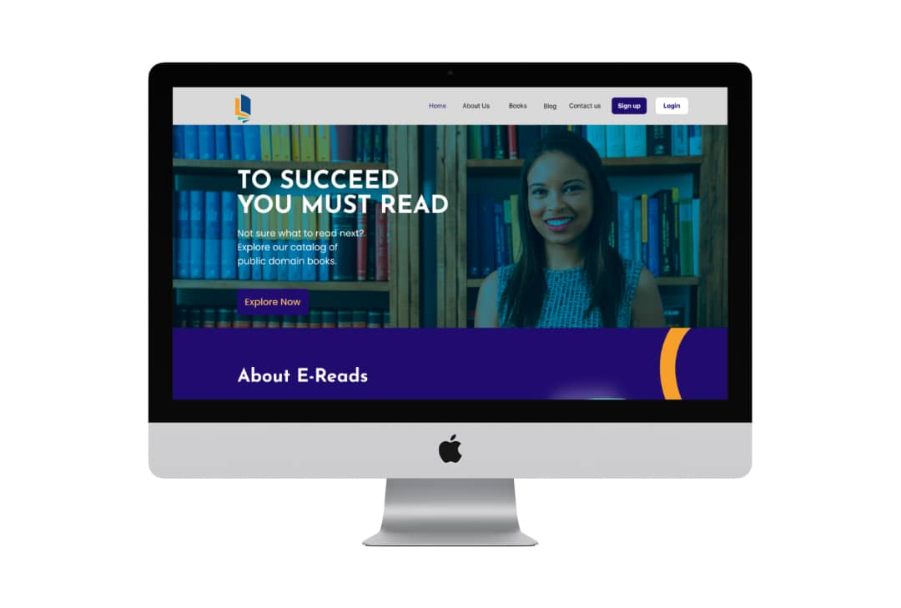
How Julia E-Library Works
We created a starting page which provides adequate information on the E-Library; this included details of our blog, founder and sponsors.
The Julia E-Library platform is a Learning Management System which our users can gain access to upon signing in or signing up.
Julia E-Library is furnished with information about the available tracks, books, courses, tutors, mentors and host of other options that will make studying uncomplicated

Slide 9








Thank You!
Notes:
Our heartfelt appreciation goes to the Nsonye Team ( Joyce, Jinanwa, Nkem, Ebube, and Chinasa), our trainers (Gb, Boma, Godswill, and Philip ) and our sponsors, Global Youth Mobilization and Jobberman, for the resources, time and overall awesomeness.
Thank you.

